Slide 1
SQL Server Table Management
Session 4

Slide 2
Objectives
Explain the general steps used to create a database
Explain the various data types in SQL Server
Define entity integrity constraints and explain the constraints needed to enforce it
Explain how to update and delete a table using T-SQL and Enterprise Manager
Explain the concepts related to constraints and constraint objects

Slide 3

Database and table
Airlines Database
Passenger
Flight_Details
Reservation

Slide 4
Design SQL Server Tables
Decide
What tables are needed
Type of data in each table
Restrictions on data
  Keys
  Default values
  Indexes
  Null values
Normalization is the process of removing the
redundancies from the incoming data.

Slide 5
Characteristics of a normalized database
Each table must have a key field
All fields must contain small data
There must be no repeating fields
Each table must contain information about a single entity
Each field in a table must depend on the key field
All non-key fields must be mutually independent

Slide 6
When to use Normalization??
When data is large and scattered
There is no defined group of data
Data is too complicated
The first step to build the database application

Slide 7
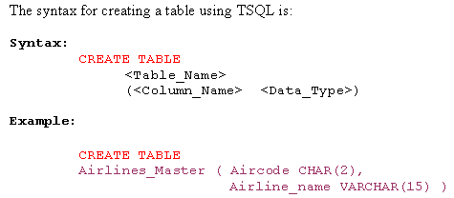
Creating Tables using
T-SQL

Slide 8
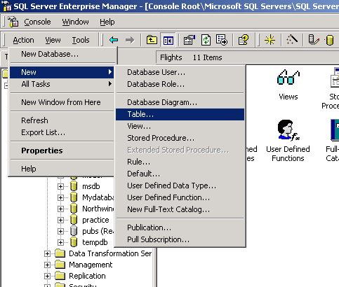
Creating Tables using Enterprise Manager-1
We can create a
new table with
the Enterprise
Manager by
selecting the
database and
then clicking
Action,New
and Table
options.

Slide 9
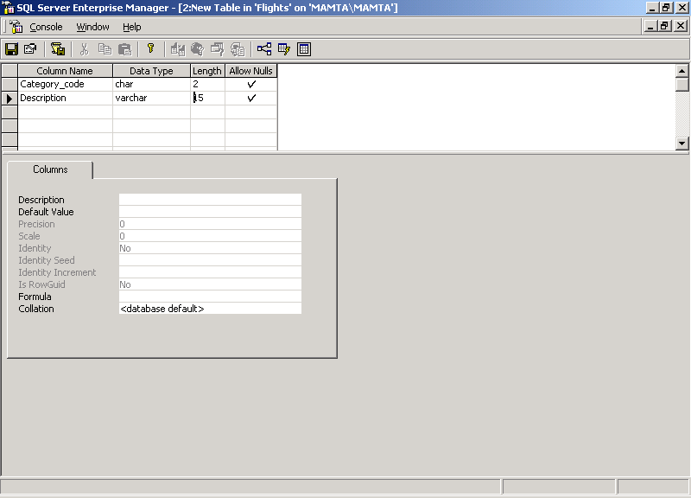
Creating Tables using Enterprise Manager-2
On selecting the Table option, the Design window
pops up where we can type in the table structure.

Slide 10
Data types
Two sets of data types are available in SQL Server 2000 :
- System Defined
Binary, varbinary,
Numeric,
Decimal, float, real
- User Defined
User defined data types are composed of system-
defined data types.

Slide 11


System defined data types
char
money
timestamp
bit
float
varchar
decimal
table
int
text
smallint
sql_variant

Slide 12
Data Integrity(1)
Data Integrity
Reliability
+
Accuracy
=

Slide 13
Data Integrity (2)
Entity integrity
Referential integrity
Data Integrity
Domain integrity
User-defined integrity

Slide 14
Entity Integrity
Entity Integrity defines a row as a unique entity for a particular table
Each table has a column that uniquely identifies the rows of that table
This column is referred as Primary key or key field or Unique key
Entity Integrity is also called as Row Integrity

Slide 15
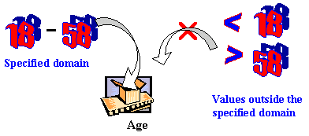
Domain Integrity
Domain refers to the group of values that are allowed for a column
Domain Integrity enforces restrictions on the values entered for a praticular column
Domain integrity specifies the validity of data entered in a given column

Slide 16
Referential Integrity
Preserves the relationship between the tables when the records are manipulted
Ensures that key values are consistent across the tables
If a key value changes, then all the references to it should also be changed accordingly

Slide 17

Referential Integrity
Use PRIMARY and
FOREIGN KEY constraints.
If item Not Found in Parent
Child
Add
Record
If Child results in Orphan Records
Parent
Delete

Slide 18
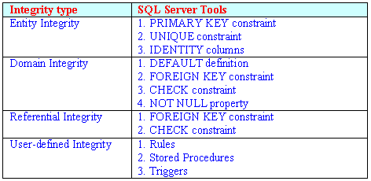
Tools for enforcing Data Integrity

Slide 19
Tools for enforcing Entity Integrity
SQL Server offers three mechanisms to
provide entity integrity
  Primary Key Constraint
  Unique Constraint
  Identity Property

Slide 20
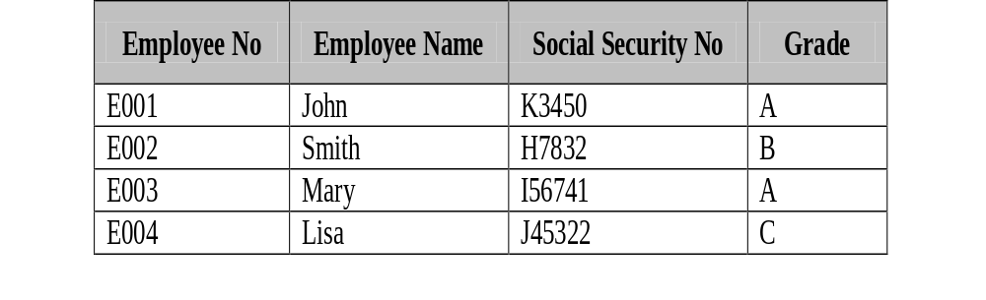
Identifying Primary key
Employee Table
Candidate Key
Candidate Key
Candidate Key

Slide 21
Minimality and Stability
In the table shown in the previous slide, the
employee number may be a candidate key, but so
could be the Social Security Number or
combination of Social Security Number and Grade.
So how do we decide which candidate key must be
used as primary key? There are two options that
help us decide this:
  minimality
  stability

Slide 22
Creating Primary key while defining the table structure
CREATE TABLE Table_name
<Column_definition> PRIMARY KEY
For example:
CREATE TABLE Reservation
( PNR_no int PRIMARY KEY )
This command will create the primary key constraint
for the column PNR_no in the Reservation table.

Slide 23
Adding primary key to already existing table
ALTER TABLE Table_name ADD CONSTRAINT
<Constraint_name> PRIMARY KEY (<Column_name>)
For example:
ALTER TABLE Reservation ADD CONSTRAINT
PK_const PRIMARY KEY PNR_no

Slide 24
UNIQUE Constraint
A column or combination of columns that is not the primary key.
Multiple UNIQUE constraints can be defined on a table, whereas only one PRIMARY KEY constraint can be defined on a table.
A column that allows null values.
UNIQUE constraints can be defined on columns that allow null values, whereas PRIMARY KEY constraints can be defined only on columns that do not allow null values.

Slide 25
IDENTITY constraint
The IDENTITY property to a column generates a value that is unique within the table. By default, the starting value set by this property is 1.
Syntax:
Column_name Data Type IDENTITY (SEED, INCREMENT)
Example:
CREATE TABLE Reservation_Copy (PNR_NO INT
IDENTITY(1,1))

Slide 26
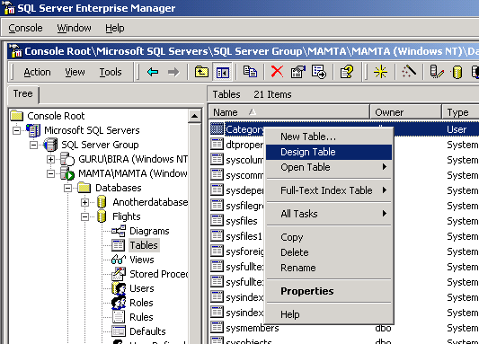
Updating structure of a table using Enterprise Manager

Slide 27
Updating structure of a table using T-SQL
ALTER TABLE <Table_Name> [ALTER COLUMN <Column_name> <New_data _type>] |ADD[Column_name <Data_Type>]| {DROP COLUMN <column _Name>
For example,
ALTER TABLE jobs ADD HIRE_DATE DATETIME
Will add the column Hire_Date to the table jobs.

Slide 28
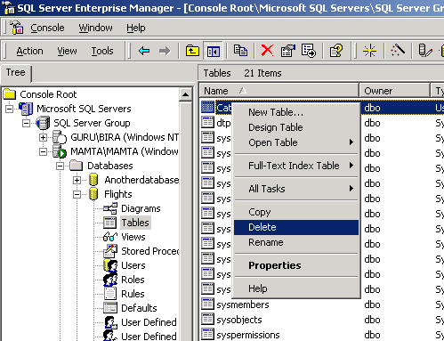
Deleting table using Enterprise Manager

Slide 29
Deleting table using T-SQL
Using T-SQL and Query Analyzer the syntax to
remove a table is as follows:
Syntax:
DROP TABLE <Table_Name>
Example:
DROP TABLE Airlines_Master

Slide 30

Constraint
A constraint is a property that can be
placed on a column or set of columns
in a table.
This is done in order to limit the data
that is entered in the column or set of
columns.
If a constraint is violated, the command that caused the violation is terminated and has no effect.

Slide 31
Constraints
- DEFAULT definition
- FOREIGN key constraint
- CHECK constraint
- NOT NULL constraint

Slide 32
Constraints for Enforcing Domain Integrity
Default Assignment
  Provides value for a column in case user does not.
Foreign Key Constraint
  Controls data that can be stored in the child table.
Check Constraint
  Limits values in a column.
Not Null Constraint
  Decides if null values are permitted in a column.

Slide 33
DEFAULT
It is used with a column of a table when:
No values have been specified
NULL should not be allowed

Slide 34
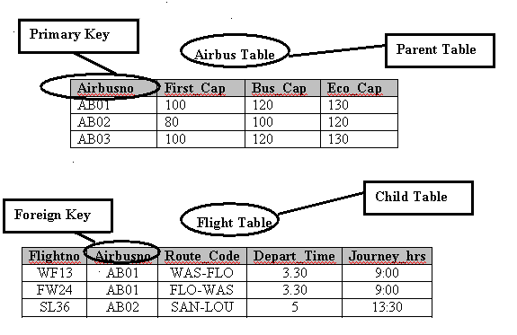
FOREIGN KEY constraint

Slide 35
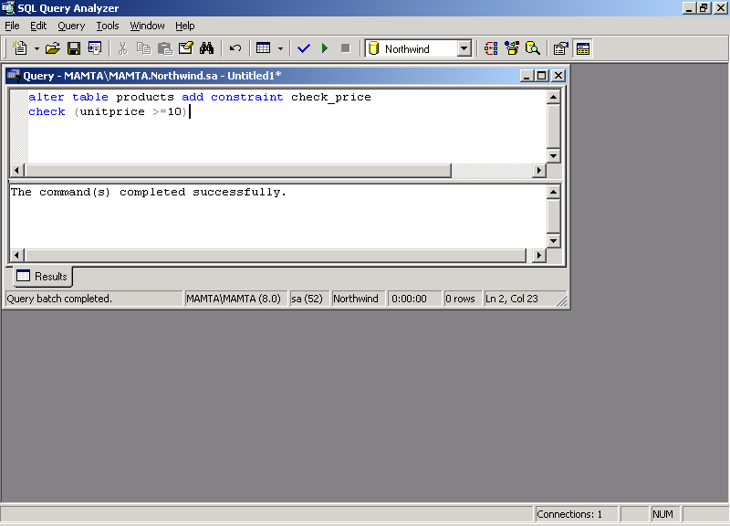
CHECK constraint
Checks for the presence
of a particular value or
its absence within a
column
Example
    Starts with “A”
    Ends in a number
    Does not contain “$”

Slide 36

Adding constraint while creating table

Slide 37
Adding constraint to an existing table

